Slide 1
Simile Poems
A poem that uses words “like” or “as” when making a comparison between two things that are not alike.

Slide 2
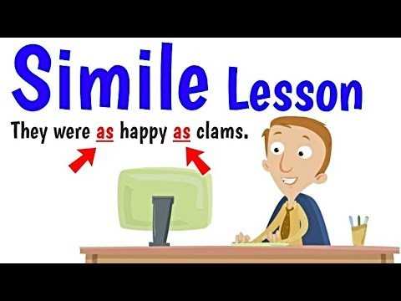

Slide 3
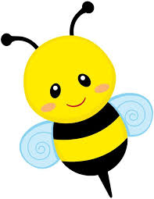
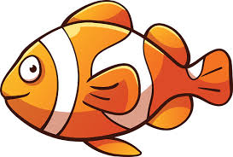
Similes
Comparing two things
Is simple as can be.
Just use “as” or “like”
And you have a simile.
He was hungry as a bear.
She was busy as a bee.
Jam is sticky as honey.
The house is tall as a tree.
Stars twinkle like diamonds.
Joe is sly like a fox.
Sally swims like a fish.
The shirt smelled like socks.

Slide 4
Let’s practice!
The pizza is as hot as _____________.
Her eyes are as blue as _____________.
I am fast like a _____________.
My teacher is as sweet as _____________.
He is as funny as _____________.
Medical workers are as brave as _____________.

Slide 5
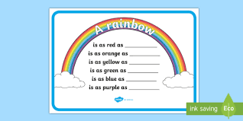

Slide 6
This week’s assignment
You will write 2 Simile Poems
*Sensory Color Poem
*Imagery Color Poem

Slide 7
Imagery Color Poem Example
Fire
Energy
Orange
Orange is energy
like a ball of fire
like a citrus fruit
as wild as a new tiger kitten.
Citrus Fruit
Tiger

Slide 8
Sensory Simile Color Poem
_____________
Color
Feels like | Tastes like | Smells like | Sounds like | Looks like

Slide 9
Sensory Simile Color Poem Example
Blue
Blue feels like freezing cold ice.
Blue tastes like blue raspberry popsicles.
Blue smells like blueberry pancakes.
Blue sounds like waves crashing on the beach.
Blue looks like a sparkling swimming pool.

Slide 10
Have fun!!!

